Slide 1
Digital Skills Health Check
Emma Procter-Legg
emma.procter-legg@it.ox.ac.uk

Slide 2
Session objectives
Digital capabilities defined
Jisc Discovery Tool and account set up
Complete a question set, reflecting on your current digital skills
Understand areas for further development
Identify suitable sources of support
Claim a digital badge

Slide 3
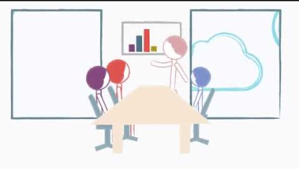
What are digital capabilities?
Notes:
I’m going to get you to watch this very short to give u an understanding of what dig cap are and what it means for you as a learner and researcher, but also to think about their role in your development as a professional in your chosen career

Slide 4
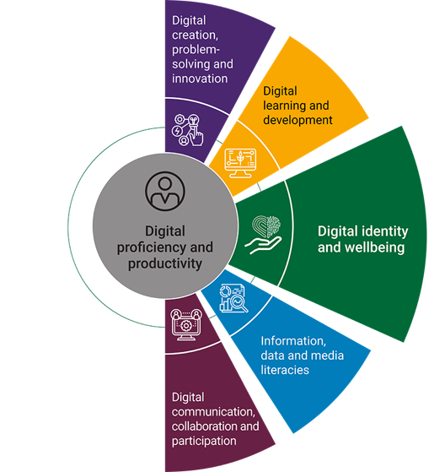
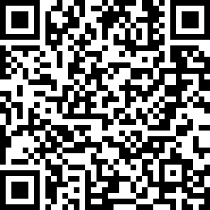
Jisc’s digital capabilities framework
https://repository.jisc.ac.uk/8846/1/2022_Jisc_BDC_Individual_Framework.pdf
Notes:
The six elements of this framework are used across over 100 HE institutions in the UK. So it is basically an industry standard developed by JISC whose work focusses on digital data and tech for education research and innovation in tertiary education.
Digital proficiency and productivity (functional or essential skills)
Information, data and media literacies (critical use)
Digital creation, problem solving and innovation (creative production)
Digital communication, collaboration and participation (participation)
Digital learning and development (development)
Digital identity and wellbeing (self-actualising)
Scan QR code for post course revision

Slide 5

Activity: Jisc Discovery Tool (20 mins)
Set up profile
Complete digital skills self-assessment (20 mins)

Slide 6
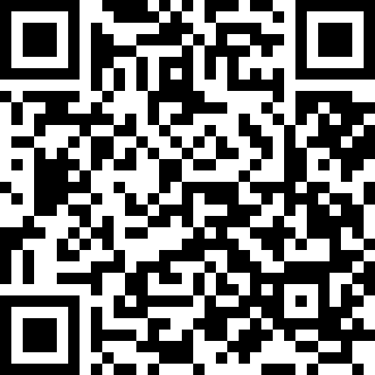
Getting started
https://skills.it.ox.ac.uk/student-digital-skills-health-check
Notes:
Student slide – if working with Staff groups swap to other QR code

Slide 7
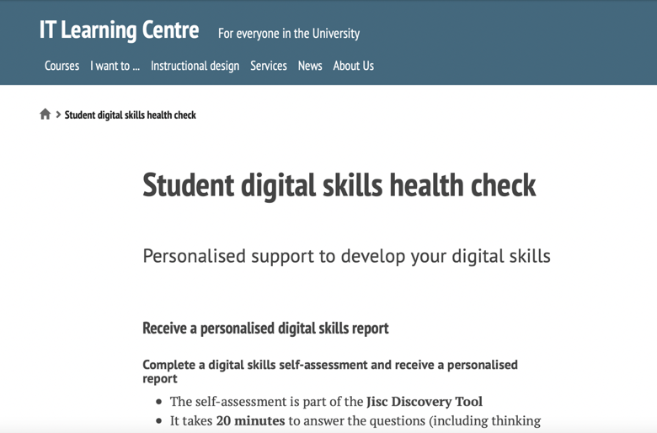

Notes:
Student slide – hide if working with staff groups

Slide 8
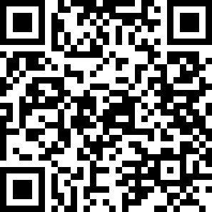
Getting started
Getting started
Getting started
https://skills.it.ox.ac.uk/jisc-discovery-tool
Notes:
Staff slide – hide if working with Student groups

Slide 9
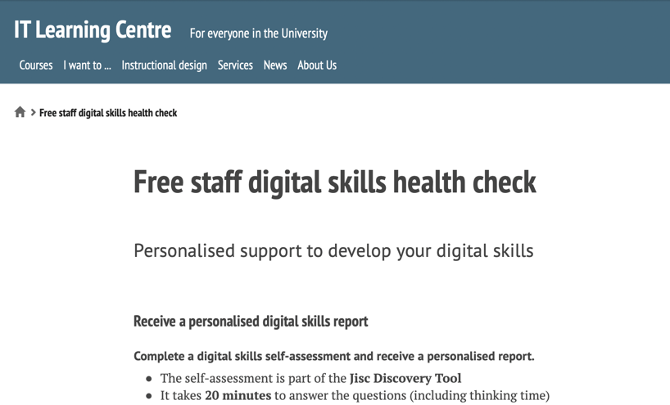
Notes:
Staff slide – hide if working with student group

Slide 10
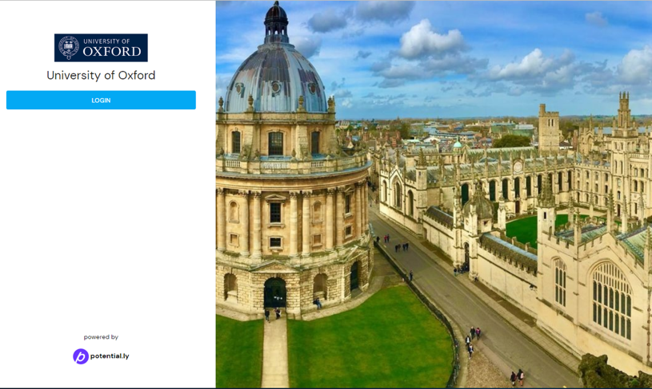

Slide 11
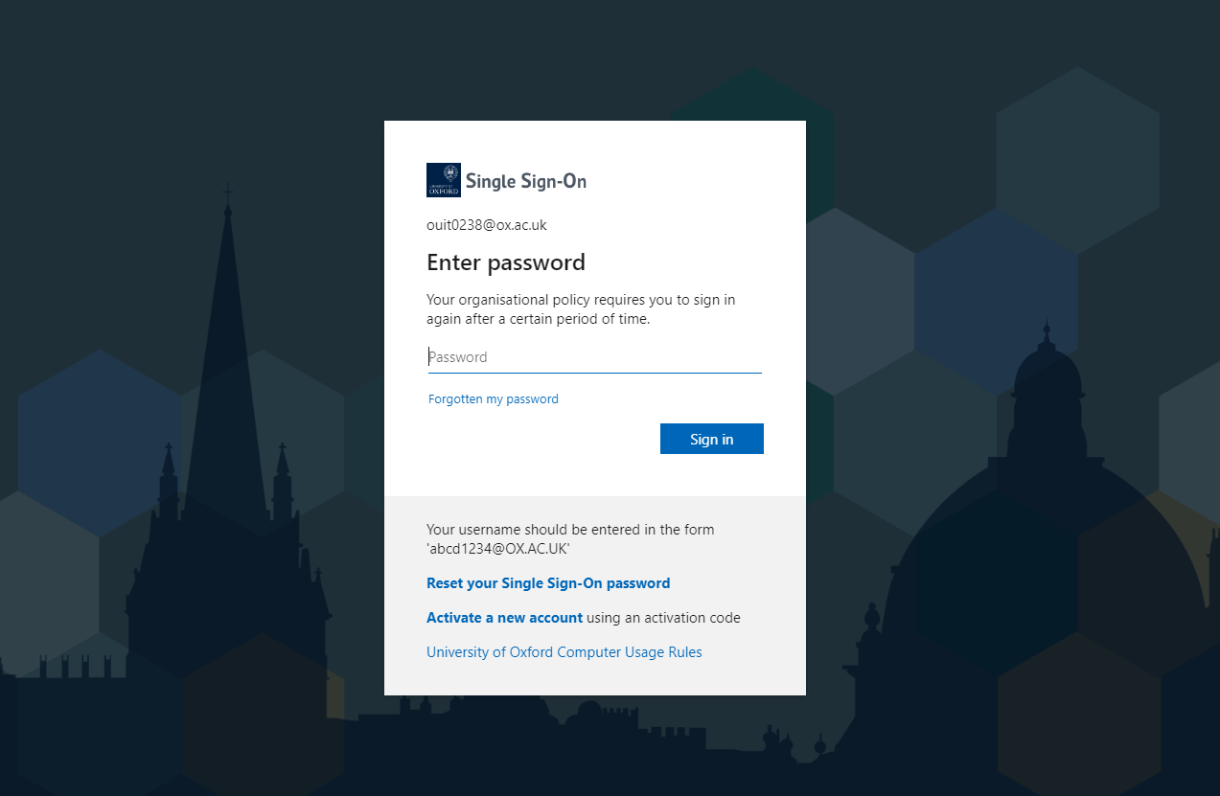

Slide 12
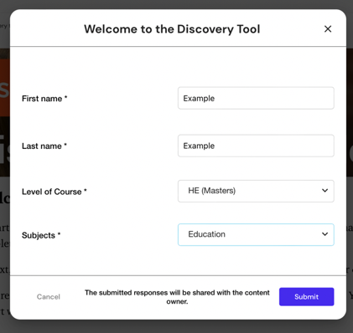
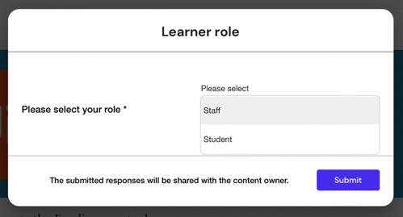
Profile set up

Slide 13
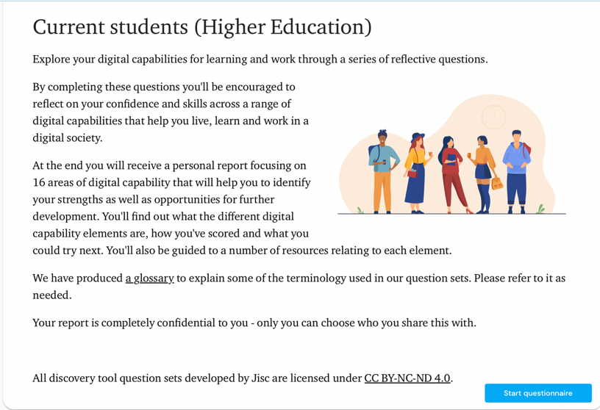
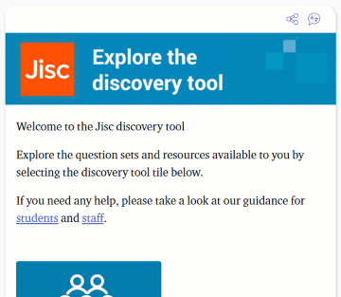

Slide 14
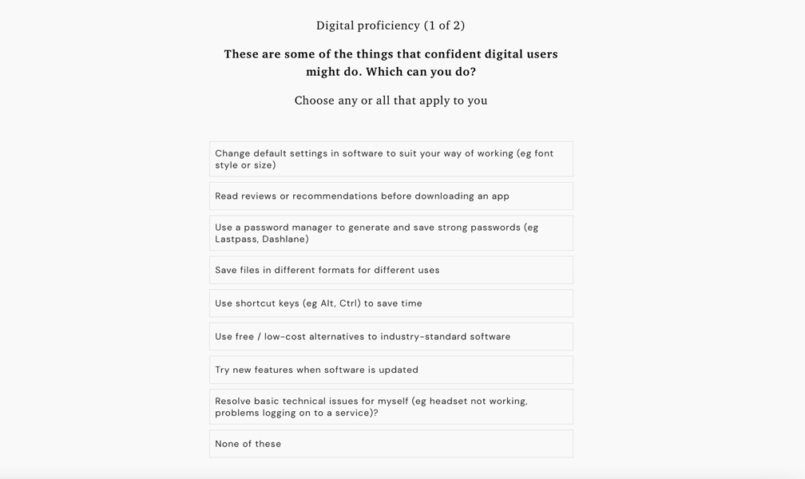
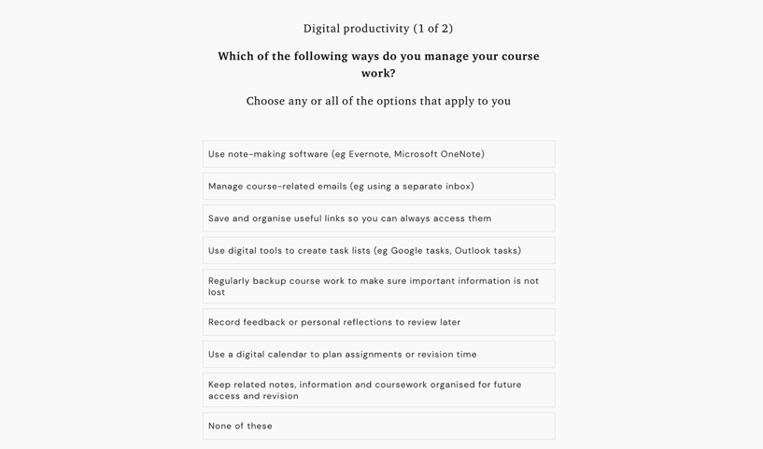

Slide 15
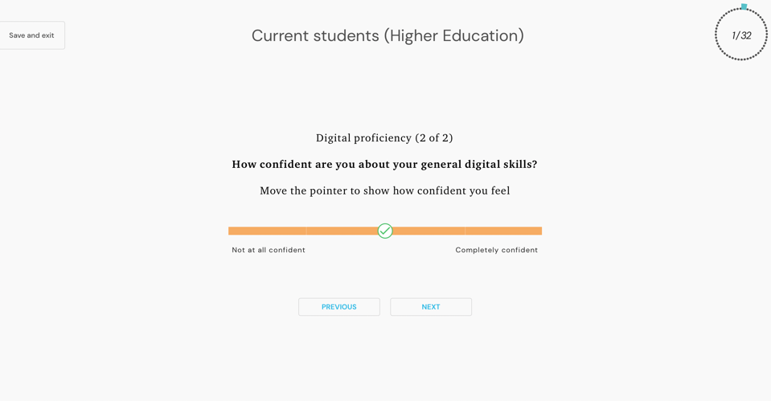

Slide 16
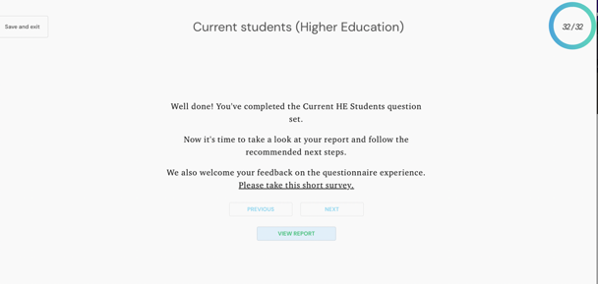
View your report

Slide 17
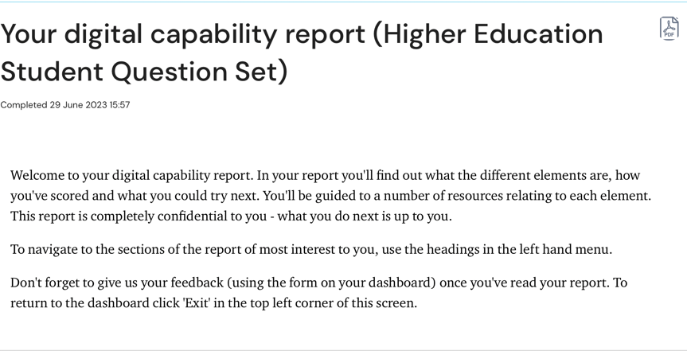
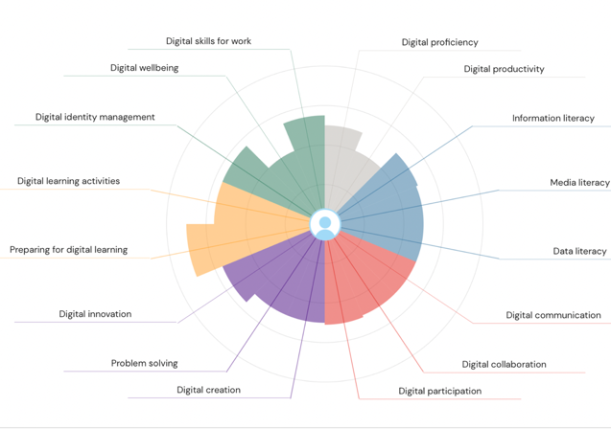

Slide 18
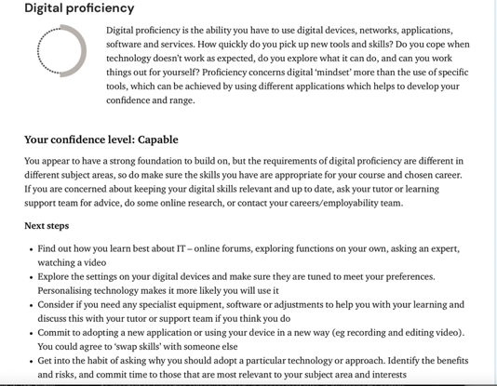
Description
Level
Action

Slide 19

Activity: Review your report (10 mins)
Choose 3 areas to focus on:
  directly related to your research
  related to your course or career ambitions
  personal option - to support a hobby or interest
Discuss these with the person sat next to you
Notes:
Student focused activity - adapt if using with staff to the following text: Choose 3 areas to focus on:​
directly related to your work or research​
related to your career ambitions​
personal option - to support a hobby or interest

Slide 20
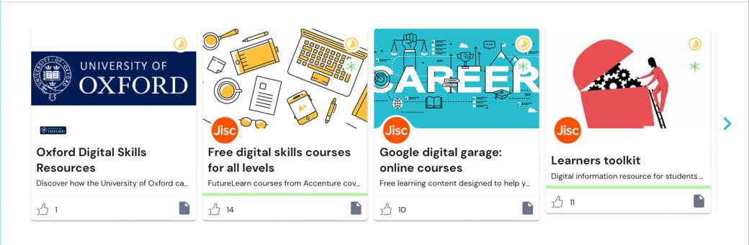

Explore the resources

Slide 21
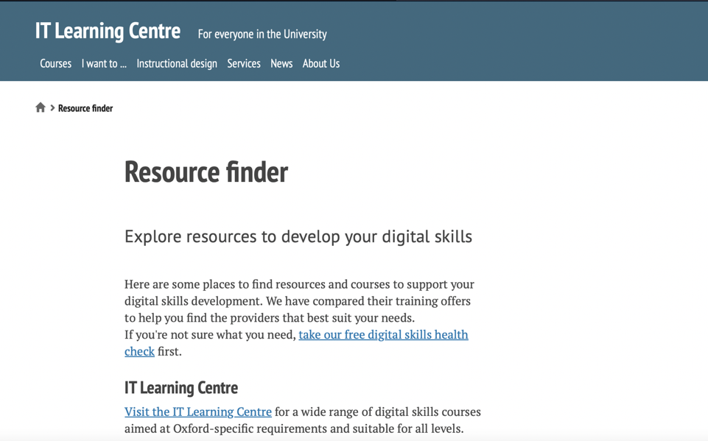
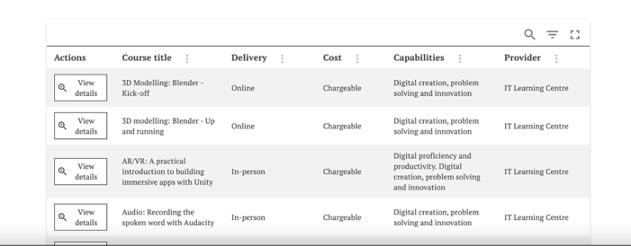

Slide 22

Acknowledgements
This presentation is made available by Emma Procter-Legg
under a Creative Commons licence:
Attribution-NonCommercial-ShareAlike
CC BY-NC-SA
Individual images maybe subject to their own licensing.
emma.procter-legg@it.ox.ac.uk

